Slide 1


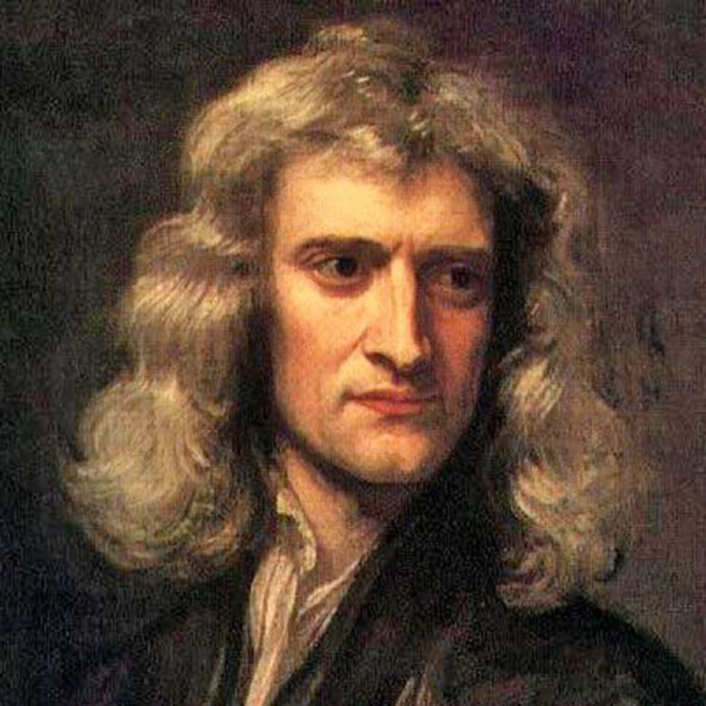
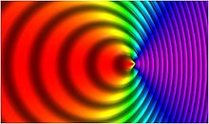
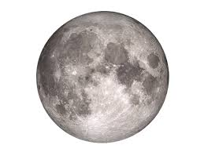
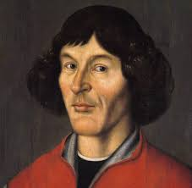
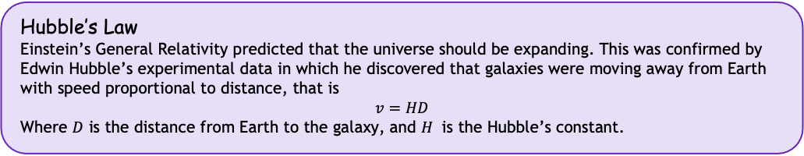
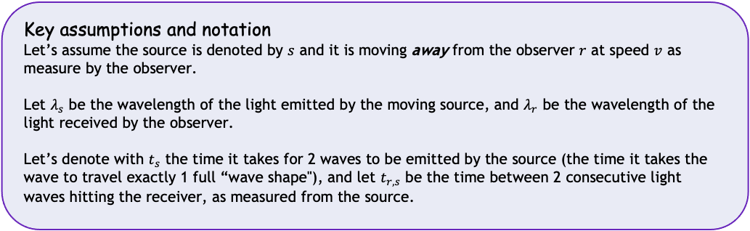
解密神奇的宇宙 Unlocking the secrets of the Universe
Project: Testing the Big Bang Theory
The Doppler Effect
Today’s VIP guest list
Whenever a wave source is moving relative to you, the length of the waves you receive will appear shifted. This is why a car coming in your direction sounds different than a car moving away once it passed you. You can imagine that a wave source that is moving is “pushing” or “puling” the waves away or towards you.
In this project you will derive and analyze the relativistic Doppler Effect for light waves, and apply it together with Hubble’s Law to measure the speed of the expansion of the Universe.
Isaac Newton
Moving wave source
Hubble’s Law
Einstein’s General Relativity predicted that the universe should be expanding. This was confirmed by Edwin Hubble’s experimental data in which he discovered that galaxies were moving away from Earth with speed proportional to distance, that is
$$v=HD$$
Where $D$ is the distance from Earth to the galaxy, and $H$ is the Hubble’s constant.
We will first derive a regular Doppler Effect for e.g. sound waves and other waves, and then use the results from Special Relativity to apply the Doppler Effect to light waves.
Key assumptions and notation
Let’s assume the source is denoted by $s$ and it is moving away from the observer $r$ at speed $v$ as measure by the observer.
Let $λ_{s}$ be the wavelength of the light emitted by the moving source, and $λ_{r}$ be the wavelength of the light received by the observer.
Let’s denote with $t_{s}$ the time it takes for 2 waves to be emitted by the source (the time it takes the wave to travel exactly 1 full “wave shape"), and let $t_{r,s}$ be the time between 2 consecutive light waves hitting the receiver, as measured from the source.

Slide 2


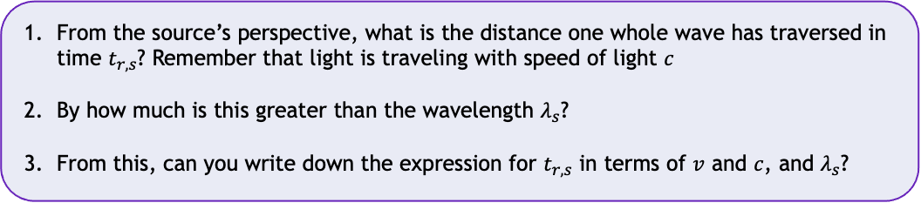
解密神奇的宇宙 Unlocking the Secrets of the Universe
Task 1
From the source’s perspective, what is the distance one whole wave has traversed in time $t_{r,s}$? Remember that light is traveling with speed of light $c$
By how much is this greater than the wavelength $λ_{s}$?
From this, can you write down the expression for $t_{r,s}$ in terms of $v$ and $c$, and $λ_{s}$?
Task 2
Assuming $v$ is large and relativistic effect of time dilation is becoming significant, what is the observer’s time $t_{r}$ when $t_{r,s}$ passes for the source?
Task 3
Using your answers to Task 1 and Task 2, what will be the $expression for \frac{λ_{r}}{λ_{s}}$ ?
From this, what is the expression for $λ_{r}$ in terms of $λ_{s}$?
What is the shift between the two values of the wavelength?
Task 4
Use your answer to Task 3 to complete the programing exercise in Python.
JinJin STEM Academy

